Slide 1

Autonomous Underwater Vehicle (AUV) Prototype Phase I and II Proposals by: SOLUTIONS
Thomas Green, Thanh Vo, Jordan Hiroshima, Jessica Sahr

Slide 2
Agenda
Proposal Overview
CONOPs
WBS/Statement of Work
Critical Path Network
Schedule
Cost Estimate
Notes:
Fix formatting

Slide 3
Proposal Overview
Option | Phase I – Base | Phase II – Option
Scope | Perform concept demo for production representative prototype | Design finalization (EMD) and production LRIP/FRP
Key Deliverables: | Concept Demo Qty 1 Production Representative Prototype | Qty 42 (Qty 6 LRIP, Qty 36 FRP)
PoP: | 12 months | EMD: 6 months Production: 18 months
Contract Type: | CPFF LOE/CPFF | CPFF/FFP
Proposal $ | $8,210,225 | $17,914,050

Slide 4
Top Level Specifications
T3 AUV can complete all missions
Surveillance and reconnaissance
Recovery of reusable underwater targets
Attached recovery lines to various objects
Designed to operate autonomously; manual override
Ultra-high frequency on surface
Low frequency while submerged
AUV communication
Communication will be encrypted for production
Demonstrations will be unencrypted
Parameter | Value
Length | 3m
Diameter | 400mm
Weight | 100kg
Operational Depth | 5ft to 200ft
Range | 5 miles
Speed | 3 knots

Slide 5
Top Level Specifications
Top Level | WBS | Specification | SOW
Systems Engineering | 1.2 | System Engineering Management Plan Test and Evaluation Management Plan Configuration Item Requirement Specifications Technical Reviews | 3.2.1 3.2.2 3.2.3 3.2.4
Hardware Engineering | 1.3 | Propulsion and Steering Sensor Payload Manipulator Communication Module Ultra-High Frequency Radio Low Frequency Radio Modulator/Demodulator AUV Controller Structural Housing Launch and Recovery System | 3.3.1.1 3.3.1.2 3.3.1.3 3.3.1.4 3.3.1.4.1 3.3.1.4.2 3.3.1.4.3 3.3.1.5 3.3.1.6 3.3.1.7
Software Engineering | 1.4 | Mission Planning Software AUV Control Software Data Analysis Software | 3.3.3.1 3.3.3.2 3.3.3.3
Integration & Test | 1.6 | Module Level Testing System Integration Demonstrations | 3.3.5
All requirements understood and covered under WBS and SOW

Slide 6
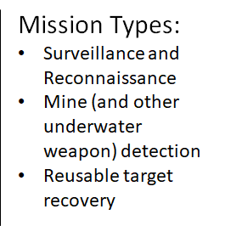
CONOPs
Transport to Area
of Operations
Load Mission Parameters
Storage
Basic AUV
CONOPS
Transport to Base
Perform Mission
Freshwater Washdown &
Maintenance
Offload Sensor Data, etc;
Data Analysis

Slide 7
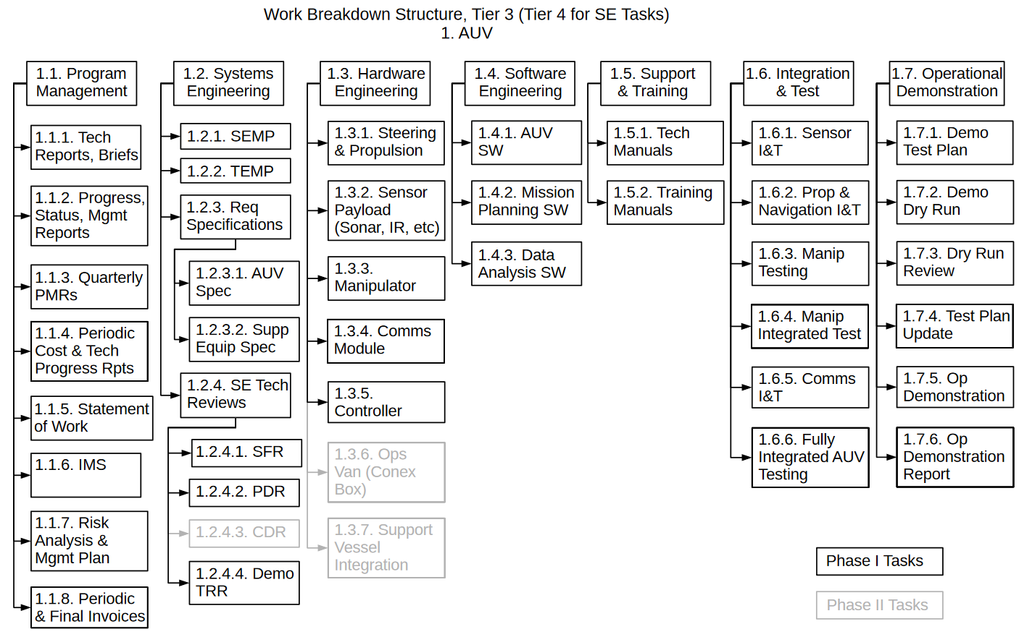
Work Breakdown Structure
Example to Tier 4 for Software
1.4. Software (SW) Engineering
1.4.1. AUV Software
1.4.1.1. Navigation
1.3.1.2. Propulsion & Steering Ctrl
1.4.1.2. Sensor Op & Data Collection
1.4.1.3. Communication
1.4.1.4. "Target" Acquisition & Posit
1.4.1.5. Manipulator Operation
1.4.1.6. Manual Override
1.4.2. Mission Planning SW
1.4.2.1. GIS Maps
1.4.2.2. Mission Parameters
1.4.3. Data Analysis SW
1.4.3.1. Imagery Analysis
1.4.3.3. Navigation Model Update

Slide 8
Statement of Work (SOW)
The Statement of Work covers the following development activities:
Program Management
Systems Engineering
Hardware Engineering
Software Engineering
Specialty Engineering, e.g.
Reliability
Structural Modeling
Support & Training
Integration & Test

Slide 9
SOW – Program Management
Monthly Status Review
Monthly Status Report
Program Management Reviews
Integrated Master Schedule
Quality Management
Configuration & Data Management

Slide 10
SOW – Systems Engineering
Systems Engineering Management Plan (SEMP)
Test Engineering Management Plan (TEMP)
Requirement Specifications for all hardware and software configuration items
Systems Engineering Technical Reviews
System Functional Review
Preliminary Design Review
Demonstration Test Readiness Review

Slide 11
SOW – Hardware Engineering
Trade studies and selection of:
Motor, Battery, Servomotors for propulsion system
Sonar, Infrared, Optical and Inertial Navigation sensors
Radios for communication module
Autonomous Controller
Development/Integration of:
Propulsion system
Payload (sensor) module
Communication module
Controller
Manipulator
Structural housing
Transport, launch and recovery system (adapted from existing hardware)

Slide 12
SOW – Software Engineering
Development/Integration of:
AUV software
Navigation
Propulsion & Steering Control
Sensor Operation & Data Collection
Communication
Target Acquisition & Positioning
Manipulator Operation
Manual Override
Mission Planning Software
GIS Map Loading
Geofencing
Mission Parameters
Data Analysis Software
Imagery Analysis
Navigation Model Updates
Target Acquisition Model Updates
Sensor Analysis

Slide 13
SOW – Integration & Test
Individual Module Testing (w/ Controller):
Sensor Testing
Propulsion & Navigation Testing
Manipulator Testing
Communication Testing
Integrated System Testing:
Full System Test – Dry
Full System Test – Wet
Demonstration Dry Run
Operational Demonstration

Slide 14
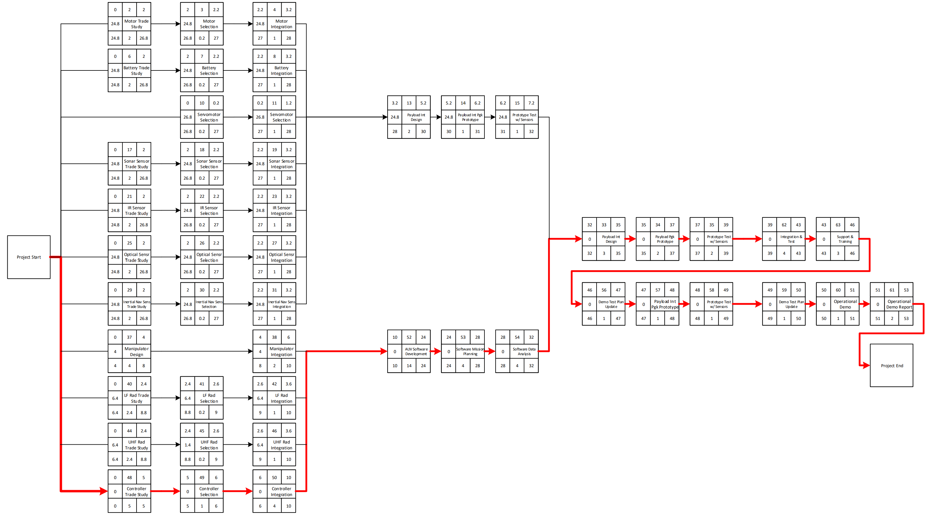
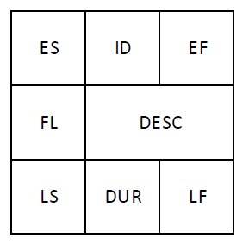
Critical Path Network

Slide 15
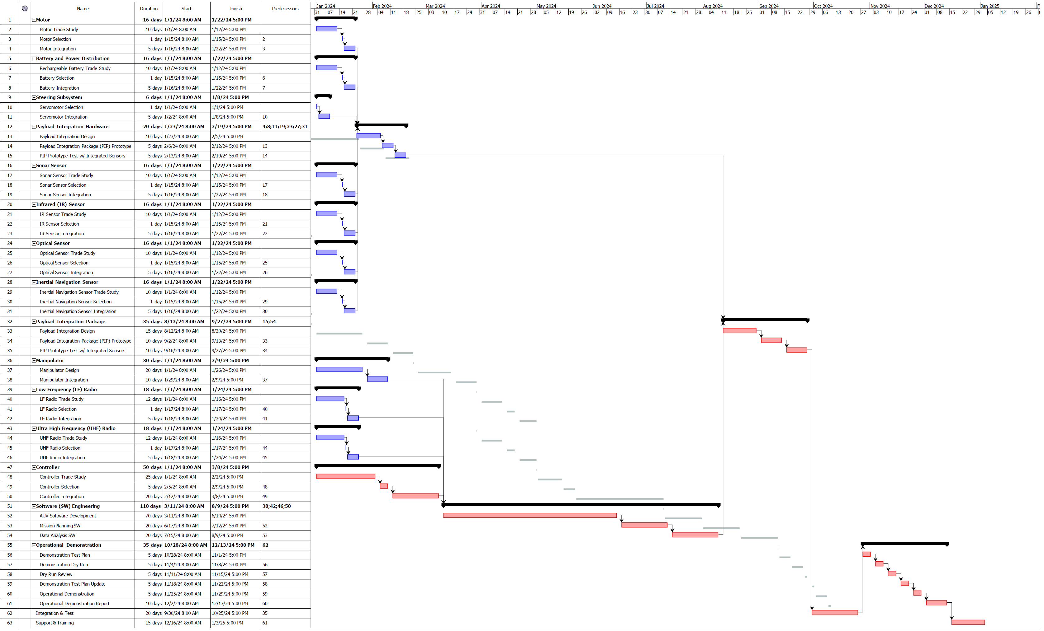
Gantt Chart
Phase I

Slide 16
Gantt Chart
Phase II

Slide 17
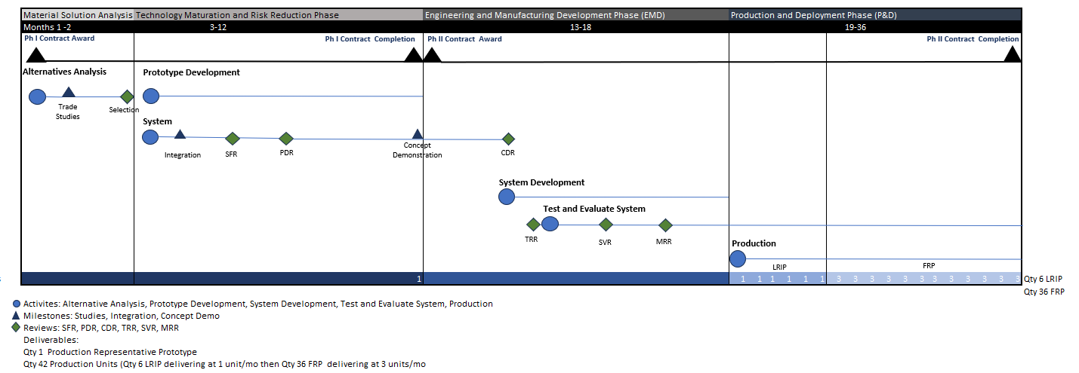
Schedule
Phase I PoP is 12 months, Phase II PoP is 24 months

Slide 18
Cost Estimate
Project Name:
Autonomous Underwater Vehicle (AUV) Prototype
Project Phases:
Phase I – Fully operational prototype development & demonstration
Phase II – Finalized design, transition to low-rate initial production (LRIP) & full-rate production (FRP)
Contract Type:
CPFF @ 10% Fee
Project Value:
Phase I - $8,210,225
Phase II - $17,914,050
Project Duration:
Phase I – 1 January 2024 – 3 January 2025 (12 months)
Phase II – 6 January 2025 – 1 January 2027 (24 months)
Phase I | Material | Labor | Travel | Test Equipment | Manufacturing Facility & Equipment
Sub-Total | $ 543,900 | $ 5,669,800 | $ 341,050 | $ 1,000,000 | $ -
Total Cost |  |  |  |  | $ 8,210,225
Phase II | Material | Labor | Travel | Test Equipment | Manufacturing Facility & Equipment
Sub-Total | $ 747,500 | $10,778,000 | $ 260,000 | $ 500,000 | $ 4,000,000
Total Cost |  |  |  |  | $ 17,914,050

